Slide 1
Memory Alignment

Slide 2
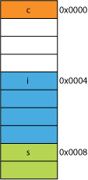
Memory
Word size on a 32 bit machine is 32 bit, and its 64 on 64bit machne
Processor always processes a single word in each cycle
In memory alignment, the data is restricted to appear in two words, which may result in padding

Slide 3
Memory alignment
To have memory alignment
char can be stored anywhere
short is stored in memory divisible by 2
e.g., at 0, 2, 4, 6, . . .
int and float is stored in memory divisible by 4
E.g., at 0, 4, 8, 12, . . .
double is stored in memory divisible by 8
E.g., at 0, 8, 16, 24, . . .

Slide 4
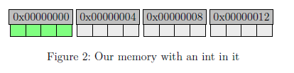
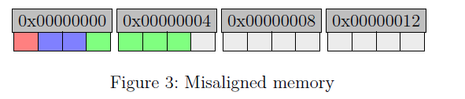
struct A {
char c;
short s;
int a;
};

Slide 5
Memory alignment
To align memory, compiler does padding at appropriate positions
To see the padding for memory alignment, we use structs and classes

Slide 6
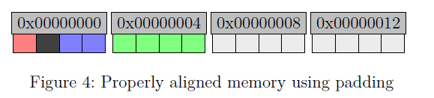
Padding
struct A {
char c;
short s;
int a;
};
Padding second byte from left shown as black box

Slide 7
Exercise: Find size
struct A
{
char c;
short s;
};
struct B
{
short s;
char c;
int i;
};
struct C
{
char c;
double d;
int i;
};
struct D
{
double d;
int i;
char c;
};
4 8 24 16

Slide 8
How to reduce default padding
declare the structure members in their increasing/decreasing order of size

Slide 9
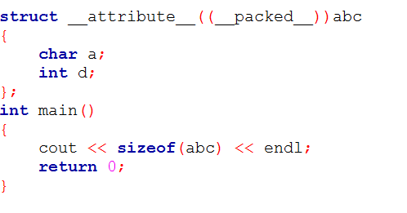
Packing
Packing is a way to avoid padding. This procedure is non standard, and varies from compiler to compiler

